Slide 1


Medical & Health Department
July 2022 Review Meeting
05.08.2022 @ Collectorate, Jayashankar Bhupalpally District

Slide 2

Maternal Health
Programme Officer Dr M Sridevi _{MBBS, DGO}

Slide 3
Maternal Health Indicators July 2022:
Sl. No | Facility Name | % of Reg against ELA | % of 1st Trimester Reg | ANC 1 % | ANC 2 % | ANC 3 % | ANC 4% | % of Anmeic Cases | Deliveries in Govt |  |  | Deliveries in Pvt
 |  |  |  |  |  |  |  |  | % of Govt Del | % of C-Sec in Govt | % of Govt Primi C-Sec | % of Pvt Del | % of C-Sec in Pvt Del
 | District Avg | 96 | 91 | 98 | 55 | 98 | 86 | 62 | 60 | 65 | 55 | 36 | 83
1 | AH Bhupalpally | 0 | 0 | 0 | 0 | 0 | 0 | 0 | 100 | 67 | 40 | 0 | 0
2 | Ambatipally(24*7 PHC) | 100 | 87 | 91 | 72 | 86 | 78 | 91 | 71 | 42 | 25 | 29 | 60
3 | Azamnagar(24*7 PHC) | 76 | 85 | 100 | 22 | 100 | 74 | 85 | 60 | 67 | 50 | 40 | 100
4 | Bhupalpally(UPHC) | 96 | 94 | 99 | 49 | 99 | 89 | 48 | 49 | 66 | 46 | 31 | 79
5 | CHC Chityal(CHC) | 0 | 0 | 0 | 0 | 0 | 0 | 0 | 100 | 100 | 0 | 0 | 0
6 | CHC Mahadevpur(CHC) | 0 | 0 | 0 | 0 | 0 | 0 | 0 | 0 | 0 | 0 | 0 | 0
7 | Chelpur(24*7 PHC) | 143 | 86 | 96 | 71 | 100 | 79 | 37 | 73 | 69 | 75 | 27 | 100
8 | Ghanpur (Mulug)(24*7 PHC) | 95 | 86 | 100 | 48 | 100 | 100 | 90 | 63 | 70 | 33 | 38 | 100
9 | Kaleswaram(PHC) | 112 | 80 | 96 | 50 | 95 | 92 | 86 | 73 | 73 | 100 | 27 | 100
10 | Kataram(24*7 PHC) | 77 | 87 | 100 | 50 | 100 | 85 | 83 | 54 | 37 | 38 | 46 | 75
11 | Maha Muthram(24*7 PHC) | 87 | 91 | 98 | 55 | 89 | 80 | 82 | 59 | 30 | 20 | 41 | 86
12 | Mogullapally(PHC) | 102 | 100 | 100 | 67 | 100 | 94 | 40 | 60 | 75 | 50 | 40 | 75
13 | Regonda(24*7 PHC) | 90 | 95 | 98 | 38 | 100 | 90 | 57 | 56 | 78 | 64 | 44 | 92
14 | Thadicharla(PHC) | 68 | 96 | 100 | 62 | 95 | 90 | 77 | 73 | 75 | 56 | 27 | 50
15 | Velishala(24*7 PHC) | 100 | 100 | 98 | 77 | 100 | 81 | 51 | 50 | 71 | 67 | 50 | 86
16 | Vodithala(PHC) | 84 | 97 | 100 | 67 | 100 | 86 | 83 | 57 | 75 | 86 | 38 | 88

Slide 4
Institutional Deliveries up to July 2022:
S. No | Facility Name | Apr-22 |  |  | May-22 |  |  | Jun-22 |  |  | Jul-21 |  |  | Total
 |  | Normal | C-Section | Total | Normal | C-Section | Total | Normal | C-Section | Total | Normal | C-Section | Total | Normal | C-Section | Total
1 | Ambatipally(24*7 PHC) | 2 | 0 | 2 | 1 | 0 | 1 | 1 | 0 | 1 | 3 | 0 | 3 | 7 | 0 | 7
2 | Azamnagar(24*7 PHC) | 0 | 0 | 0 | 0 | 0 | 0 | 0 | 0 | 0 | 0 | 0 | 0 | 0 | 0 | 0
3 | Bhupalpally(UPHC) | 0 | 0 | 0 | 0 | 0 | 0 | 1 | 0 | 1 | 0 | 0 | 0 | 1 | 0 | 1
6 | Chelpur(24*7 PHC) | 0 | 0 | 0 | 0 | 0 | 0 | 0 | 0 | 0 | 1 | 0 | 1 | 1 | 0 | 1
7 | Ghanpur (Mulug)(24*7 PHC) | 1 | 0 | 1 | 1 | 0 | 1 | 3 | 0 | 3 | 0 | 0 | 0 | 5 | 0 | 5
7 | Kaleshwram (PHC) | 0 | 0 | 0 | 0 | 0 | 0 | 0 | 0 | 0 | 0 | 0 | 0 | 0 | 0 | 0
8 | Kataram(24*7 PHC) | 3 | 0 | 3 | 7 | 0 | 7 | 5 | 0 | 5 | 9 | 0 | 9 | 24 | 0 | 24
9 | Maha Muthram(24*7 PHC) | 0 | 0 | 0 | 1 | 0 | 1 | 0 | 0 | 0 | 3 | 0 | 3 | 4 | 0 | 4
10 | Mogullapally(PHC) | 0 | 0 | 0 | 0 | 0 | 0 | 0 | 0 | 0 | 0 | 0 | 0 | 0 | 0 | 0
11 | Regonda(24*7 PHC) | 0 | 0 | 0 | 0 | 0 | 0 | 3 | 0 | 3 | 2 | 0 | 2 | 5 | 0 | 5
12 | Thadicharla(PHC) | 0 | 0 | 0 | 0 | 0 | 0 | 0 | 0 | 0 | 0 | 0 | 0 | 0 | 0 | 0
13 | Velishala(24*7 PHC) | 0 | 0 | 0 | 0 | 0 | 0 | 0 | 0 | 0 | 0 | 0 | 0 | 0 | 0 | 0
14 | Vodithala(PHC) | 0 | 0 | 0 | 0 | 0 | 0 | 0 | 0 | 0 | 0 | 0 | 0 | 0 | 0 | 0
 | Total | 6 | 0 | 6 | 10 | 0 | 10 | 13 | 0 | 13 | 18 | 0 | 18 | 47 | 0 | 47
1 | CHC Chityal(CHC) | 2 | 20 | 22 | 4 | 22 | 26 | 4 | 10 | 14 | 5 | 17 | 22 | 15 | 69 | 84
2 | CHC Mahadevpur(CHC) | 13 | 0 | 13 | 9 | 0 | 9 | 9 | 0 | 9 | 5 | 0 | 5 | 36 | 0 | 36
3 | AH Bhupalpally(AH) | 30 | 44 | 74 | 50 | 41 | 91 | 45 | 42 | 87 | 40 | 69 | 109 | 165 | 196 | 361
 | Total | 45 | 64 | 109 | 63 | 63 | 126 | 58 | 52 | 110 | 50 | 86 | 136 | 216 | 265 | 481
 | Grand Total | 51 | 64 | 115 | 73 | 63 | 136 | 71 | 52 | 123 | 68 | 86 | 154 | 263 | 265 | 528

Slide 5
Private Institutional Deliveries up to July 2022:
S. No | Name of the Hospital | Apr-22 |  | May-22 |  | Jun-22 |  | Jul-21 |  | Total
 |  | Normal | C-Section | Normal | C-Section | Normal | C-Section | Normal | C-Section | Normal | C-Section
1 | Sai Rathna Nursing Home | 0 | 24 | 0 | 23 | 4 | 15 | 13 | 13 | 17 | 75
2 | Kiran Hospital | 0 | 7 | 2 | 10 | 0 | 4 | 1 | 3 | 3 | 24
3 | Sai Nursing Home | 0 | 0 | 0 | 2 | 0 | 0 | 0 | 0 | 0 | 2
4 | VInay Hospital | 0 | 0 | 0 | 0 | 0 | 0 | 0 | 0 | 0 | 0
5 | Sai Balaji Multi Specialty Hospital | 0 | 0 | 0 | 2 | 1 | 4 | 0 | 2 | 1 | 8
6 | Global Care Hospital | 0 | 0 | 0 | 0 | 1 | 2 | 0 | 3 | 1 | 5
7 | Pradhan Hospital | 0 | 0 | 0 | 0 | 0 | 0 | 0 | 0 | 0 | 0
8 | Surya Hospital | 0 | 0 | 0 | 1 | 0 | 2 | 1 | 0 | 1 | 3
9 | Sri Srinivasa Hospital | 0 | 0 | 0 | 0 | 0 | 0 | 1 | 0 | 1 | 0
10 | Smart Care Hospital | 0 | 0 | 0 | 0 | 0 | 0 | 0 | 0 | 0 | 0
11 | Sri Raja Rajeshwara Hospital | 0 | 0 | 0 | 0 | 0 | 0 | 0 | 0 | 0 | 0
12 | Sri Medha Multi Speciality Hospital | 0 | 6 | 0 | 5 | 0 | 6 | 2 | 9 | 2 | 26
13 | New Life Line Hospital | 0 | 0 | 0 | 0 | 0 | 0 | 0 | 0 | 0 | 0
 | Total | 0 | 37 | 2 | 43 | 6 | 33 | 18 | 30 | 26 | 143

Slide 6
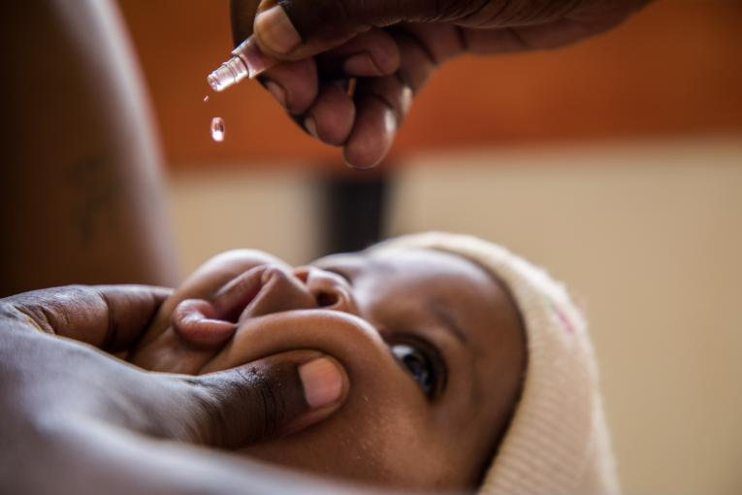
Child Health &
Immunization
Programme Officer Dr B Ravi Kumar _{MBBS}

Slide 7
HMIS -Facility Wise Immunization data Target vs Achievement in July 2022:
S. No. | Name of the PHC | Annual ELA | Prop. ELA | Birth Dose BCG | % | Penta 1 | % | Penta 3 | % | MR1 | % | Fully Immunized | % | MR2 | %
1 | Ambatpally | 670 | 56 | 77 | 138 | 79 | 141 | 49 | 88 | 79 | 141 | 63 | 113 | 68 | 143
2 | Azamnagar | 269 | 22 | 18 | 80 | 19 | 85 | 22 | 98 | 18 | 80 | 18 | 80 | 19 | 100
3 | Bhupalpally | 1342 | 112 | 61 | 55 | 89 | 80 | 101 | 90 | 99 | 89 | 99 | 89 | 95 | 100
4 | Chelpur | 371 | 31 | 28 | 91 | 31 | 100 | 32 | 104 | 42 | 136 | 29 | 94 | 32 | 122
5 | Chityala | 0 | 0 | 22 | 0 | 0 | 0 | 0 | 0 | 0 | 0 | 0 | 0 | 0 | 0
6 | Ghanpur | 255 | 21 | 11 | 52 | 16 | 75 | 20 | 94 | 27 | 127 | 23 | 108 | 21 | 116
7 | Kataram | 650 | 54 | 48 | 89 | 55 | 102 | 56 | 103 | 65 | 120 | 65 | 120 | 57 | 124
8 | Mahadevpoor | 0 | 0 | 4 | 0 | 0 | 0 | 0 | 0 | 0 | 0 | 0 | 0 | 0 | 0
9 | Mahamutharam | 458 | 38 | 23 | 60 | 32 | 84 | 32 | 84 | 31 | 81 | 31 | 81 | 27 | 83
10 | Mogullapally | 625 | 52 | 22 | 42 | 36 | 69 | 42 | 81 | 37 | 71 | 37 | 71 | 40 | 90
11 | private | 0 | 0 | 48 | 0 | 0 | 0 | 0 | 0 | 0 | 0 | 0 | 0 | 0 | 0
12 | Regonda | 1038 | 87 | 69 | 80 | 88 | 102 | 90 | 104 | 89 | 103 | 89 | 103 | 79 | 107
13 | Thadicherla | 441 | 37 | 25 | 68 | 43 | 117 | 39 | 106 | 41 | 112 | 38 | 103 | 28 | 90
14 | UPHC Bhupalpally | 0 | 0 | 0 | 0 | 0 | 0 | 0 | 0 | 0 | 0 | 0 | 0 | 0 | 0
15 | Velishala | 559 | 47 | 26 | 56 | 39 | 84 | 39 | 84 | 43 | 92 | 35 | 75 | 43 | 109
16 | Vodithala | 579 | 48 | 16 | 33 | 48 | 99 | 44 | 91 | 46 | 95 | 46 | 95 | 38 | 93
 | Total | 7257 | 605 | 498 | 82 | 575 | 95 | 566 | 94 | 617 | 102 | 573 | 95 | 547 | 106

Slide 8
COVID Vaccination Report as on 04.08.2022:
S.No. | PHC Name | 18+ |  | 12-14 |  | 15-17 |  | % of 18+ Precaution Dose
 |  | % of 1st Dose | % of 2nd Dose | % of 1st Dose | % of 2nd Dose | % of 1st Dose | % of 2nd Dose
1 | Ambatpally PHC | 104 | 102 | 104 | 88 | 85 | 81 | 6
2 | Azamnagar PHC | 102 | 106 | 120 | 129 | 101 | 99 | 24
3 | Bhupalpally PHC | 105 | 106 | 110 | 114 | 105 | 106 | 9
4 | Chelpur PHC | 112 | 107 | 102 | 83 | 59 | 121 | 6
5 | Ghanpur PHC | 106 | 101 | 104 | 100 | 98 | 54 | 5
6 | Kataram PHC | 104 | 91 | 102 | 79 | 88 | 82 | 7
7 | Mahamutharam PHC | 104 | 99 | 105 | 94 | 72 | 66 | 7
8 | Mogullapally PHC | 102 | 103 | 105 | 105 | 100 | 99 | 14
9 | Regonda PHC | 104 | 106 | 126 | 128 | 97 | 95 | 13
10 | Thadicherla PHC | 107 | 109 | 113 | 113 | 104 | 98 | 10
11 | Velishala PHC | 103 | 105 | 167 | 252 | 95 | 75 | 5
12 | Vodithala PHC | 105 | 104 | 134 | 134 | 98 | 100 | 9
 | Total | 105 | 103 | 112 | 108 | 94 | 93 | 10

Slide 9
RBSK Report in July 2022:
S.No. | PHC Name | Institutions |  | Childrens |  | Screened |  | 4Ds (30Ds) Found |  | Referred |  | Under Treatment |  | Treatment Success |  | No of Childrens in
 |  | Schools | AWCs | Schools | AWCs | Schools | AWCs | Schools | AWCs | Schools | AWCs | Schools | AWCs | Schools | AWCs | SAM | MAM | Sickle cell Anemia
1 | Ambatpally PHC | 60 | 70 | 623 | 201 | 402 | 101 | 10 | 7 | 8 | 0 | 0 | 0 | 0 | 0 | 0 | 0 | 0
2 | Azamnagar PHC | 17 | 28 | 0 | 0 | 0 | 0 | 0 | 0 | 0 | 0 | 0 | 0 | 0 | 0 | 0 | 0 | 0
3 | Bhupalpally PHC | 46 | 93 | 398 | 248 | 241 | 155 | 23 | 11 | 13 | 3 | 0 | 0 | 10 | 3 | 2 | 1 | 0
4 | Chelpur PHC | 19 | 27 | 0 | 0 | 0 | 0 | 0 | 0 | 0 | 0 | 0 | 0 | 0 | 0 | 0 | 0 | 0
5 | Ghanpur PHC | 13 | 24 | 0 | 0 | 0 | 0 | 0 | 0 | 0 | 0 | 0 | 0 | 0 | 0 | 0 | 0 | 0
7 | Kataram PHC | 55 | 59 | 4415 | 1948 | 0 | 0 | 0 | 0 | 0 | 0 | 0 | 0 | 0 | 0 | 0 | 0 | 0
8 | Mahamutharam PHC | 49 | 59 | 2729 | 1847 | 751 | 285 | 19 | 0 | 19 | 0 | 0 | 0 | 7 | 0 | 0 | 0 | 0
9 | Mogullapally PHC | 38 | 60 | 400 | 144 | 311 | 40 | 15 | 0 | 15 | 0 | 4 | 0 | 3 | 0 | 0 | 0 | 0
10 | Regonda PHC | 51 | 81 | 0 | 0 | 0 | 0 | 0 | 0 | 0 | 0 | 0 | 0 | 0 | 0 | 0 | 0 | 0
11 | Thadicherla PHC | 36 | 38 | 211 | 51 | 94 | 32 | 2 | 2 | 0 | 0 | 0 | 0 | 0 | 0 | 0 | 0 | 0
12 | Velishala PHC | 32 | 50 | 0 | 0 | 0 | 0 | 0 | 0 | 0 | 0 | 0 | 0 | 0 | 0 | 0 | 0 | 0
13 | Vodithala PHC | 40 | 55 | 0 | 0 | 0 | 0 | 0 | 0 | 0 | 0 | 0 | 0 | 0 | 0 | 0 | 0 | 0
 | Total | 456 | 644 | 8776 | 4439 | 1799 | 613 | 69 | 20 | 55 | 3 | 4 | 0 | 20 | 3 | 2 | 1 | 0

Slide 10
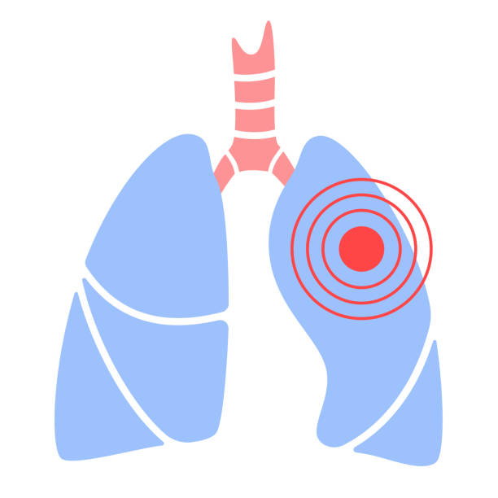
National Tuberculosis
Elimination Programme
Programme Officer Dr M Kommuraiah _{MBBS}

Slide 11
TB Notification in Jayashankar Bhupalpally District for the period of January 2022 to July 2022
SL. No | TU Name | PHC Name | % of Notification | % of UDST | % of TB HIV | % of Success Rate | % of Validation | Samples Collection
1 | Bhupalpally | Azamnagar(24*7 PHC) | 333 | 90 | 90 | 100 | 50 | 308
2 | Bhupalpally | Bhupalpally(UPHC) | 27 | 75 | 75 | 100 | 75 | 1443
3 | Bhupalpally | Chelpur(24*7 PHC) | 50 | 100 | 100 | 0 | 50 | 399
4 | Bhupalpally | Ghanpur (Mulug)(24*7 PHC) | 133 | 75 | 100 | 0 | 50 | 189
5 | Kataram | Ambatipally(24*7 PHC) | 67 | 100 | 100 | 100 | 0 | 237
6 | Kataram | CHC Mahadevpur(CHC) | 0 | 0 | 0 | 0 | 0 | 0
7 | Kataram | Kaleswaram(PHC) | 0 | 0 | 0 | 100 | 0 | 340
8 | Kataram | Kataram(24*7 PHC) | 57 | 75 | 75 | 0 | 75 | 506
9 | Kataram | Maha Muthram(24*7 PHC) | 60 | 67 | 100 | 100 | 100 | 551
10 | Kataram | Thadicharla(PHC) | 60 | 67 | 100 | 0 | 33 | 516
11 | Regonda | CHC Chityal(CHC) | 0 | 0 | 0 | 0 | 0 | 0
12 | Regonda | Mogullapally(PHC) | 29 | 100 | 100 | 100 | 100 | 1369
13 | Regonda | Regonda(24*7 PHC) | 64 | 86 | 86 | 100 | 71 | 1266
14 | Regonda | Velishala(24*7 PHC) | 50 | 67 | 100 | 100 | 33 | 516
15 | Regonda | Vodithala(PHC) | 67 | 75 | 100 | 100 | 75 | 925
 |  | Total | 61 | 81 | 92 | 100 | 60 | 8565

Slide 12
DBT Status from Jan 22 to July 2022
Sl. No | District | Total Notified | No of DBT Paid | %
1 | Jayashankar Bhupalpally | 385 | 322 | 84

Slide 13

Non Communicable Diseases
Programme Officer Dr S Gopinath _{MBBS}

Slide 14
PHC Wise NCD Screening Report as on 04.08.2022:
S No | PHC Name | % of Population Enrolled in VHR | % ADP Completed Population | Target Population as per VHR | Total Screening Done | % of Total Screening Done | Balance to be Screened | % Balance to be Screened | Total No of Suspected for HTN & DM and Referred to MO | HTN & DM Balance at MO | % balance at MO
1 | Ambatipally(24*7 PHC) | 81 | 77 | 7141 | 6957 | 97 | 184 | 3 | 1393 | 0 | 0
2 | Azamnagar(24*7 PHC) | 88 | 85 | 6870 | 6650 | 97 | 220 | 3 | 912 | 0 | 0
3 | Bhupalpally(UPHC) | 91 | 86 | 31740 | 31229 | 98 | 511 | 2 | 4656 | 1 | 0
4 | Chelpur(24*7 PHC) | 98 | 92 | 11682 | 11110 | 95 | 572 | 5 | 1457 | 146 | 10
5 | Ghanpur (Mulug)(24*7 PHC) | 98 | 98 | 7803 | 7681 | 98 | 122 | 2 | 847 | 1 | 0
6 | Kaleswaram(PHC) | 76 | 70 | 10088 | 9473 | 94 | 615 | 6 | 1590 | 0 | 0
7 | Kataram(24*7 PHC) | 83 | 78 | 17011 | 15872 | 93 | 1139 | 7 | 2421 | 2 | 0
8 | Maha Muthram(24*7 PHC) | 86 | 82 | 12500 | 11744 | 94 | 756 | 6 | 946 | 0 | 0
9 | Mogullapally(PHC) | 97 | 96 | 20370 | 20213 | 99 | 157 | 1 | 2535 | 0 | 0
10 | Regonda(24*7 PHC) | 96 | 94 | 34082 | 33699 | 99 | 383 | 1 | 4561 | 0 | 0
11 | Thadicharla(PHC) | 79 | 75 | 12369 | 11528 | 93 | 841 | 7 | 1121 | 0 | 0
12 | Velishala(24*7 PHC) | 95 | 90 | 14772 | 14189 | 96 | 583 | 4 | 3126 | 569 | 18
13 | Vodithala(PHC) | 90 | 83 | 16607 | 15802 | 95 | 805 | 5 | 1539 | 0 | 0
 | Total | 90 | 86 | 203035 | 196147 | 97 | 6888 | 3 | 27104 | 719 | 3

Slide 15

Integrated Health
Information Platform
Programme Officer Dr B Ravi Kumar _{MBBS}

Slide 16
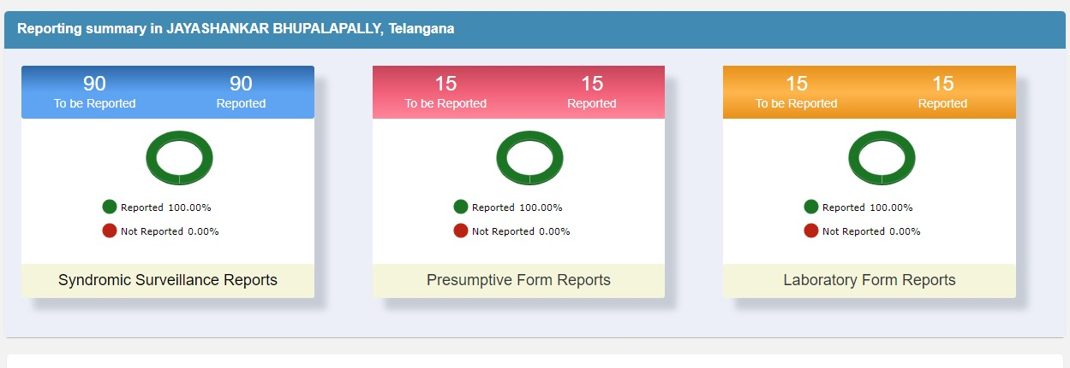
IHIP - S, P and L Form Reporting Status in the month of July 2022

Slide 17
Case Reporting status in S, P and L Forms for the month of July 2022
S. No | Sub-district | Syndromic Surveillance Cases |  | Presumptive Cases |  | Laboratory Cases
 |  | Cases | Deaths | Cases | Deaths | Persons Tested | Samples Tested | Positive
 | Total | 7963 | 0 | 1867 | 0 | 1530 | 1534 | 4
1 | Bhupalpally | 2059 | 0 | 354 | 0 | 228 | 230 | 0
2 | Chityal | 640 | 0 | 265 | 0 | 198 | 198 | 1
3 | Ghanpur (Mulug) | 639 | 0 | 260 | 0 | 78 | 78 | 0
4 | Kataram | 332 | 0 | 247 | 0 | 140 | 140 | 0
5 | Mahadevpur | 1036 | 0 | 189 | 0 | 268 | 268 | 3
6 | Malharrao | 224 | 0 | 46 | 0 | 30 | 30 | 0
7 | Mogullapally | 925 | 0 | 95 | 0 | 170 | 171 | 0
8 | MUTHARAM MAHADEVPUR | 555 | 0 | 89 | 0 | 52 | 52 | 0
9 | Palimela | 74 | 0 | 0 | 0 | 1 | 1 | 0
10 | Regonda | 1050 | 0 | 265 | 0 | 278 | 279 | 0
11 | Tekumatla | 429 | 0 | 57 | 0 | 87 | 87 | 0

Slide 18
Seasonal Diseases Report for the month of July 2022
Acute Diarrhoeal Disease (including acute gastroenteritis) | 346
Fever of Unknown Origin (PUO) | 1519
Acute Respiratory Infection (ARI) / Influenza Like Illness (ILI) | 1082
Dog bite | 257
Snake bite | 10
Monkey Bite | 123
Cat Bite | 5
Rat Bite | 3
Any Other Bite | 8

Slide 19


E-Aushadhi, OPD,
IPD & Lab Test

Slide 20
eAushadhi Patient Count Month Wise Report from January 2022 to July 2022:
Hod | S.No | HospitalName | HospitalType | JAN | FEB | MAR | APR | MAY | JUN | JUL
DPH | 1 | Ambatpalli Phc | PHC | 1835 | 1789 | 2082 | 2050 | 2297 | 2676 | 2775
DPH | 2 | Azamnagar Phc | PHC | 916 | 1356 | 435 | 564 | 1205 | 811 | 1736
DPH | 3 | Chelpur Phc | PHC | 565 | 726 | 1090 | 2113 | 1455 | 2401 | 254
DPH | 4 | Ghanpur(Mulugu) Phc | PHC | 868 | 646 | 394 | 1261 | 2237 | 2384 | 2287
DPH | 5 | Kaleshwaram PHC | PHC | 0 | 0 | 0 | 0 | 0 | 0 | 0
DPH | 6 | Kataram Phc | PHC | 1576 | 2384 | 2483 | 2604 | 2152 | 2312 | 2231
DPH | 7 | Mogullapalli Phc | PHC | 822 | 945 | 565 | 350 | 1711 | 2674 | 2963
DPH | 8 | Mutharam Mahad Phc | PHC | 1084 | 1217 | 1159 | 1260 | 1370 | 1801 | 1950
DPH | 9 | Odithala Phc | PHC | 1371 | 1406 | 1490 | 1992 | 2430 | 2819 | 2863
DPH | 10 | Regonda Phc | PHC | 760 | 883 | 1012 | 2146 | 2528 | 2538 | 2459
DPH | 11 | Tadicherla Phc | PHC | 2133 | 2230 | 2690 | 2846 | 2526 | 2180 | 2739
DPH | 12 | Velishala Phc | PHC | 1085 | 322 | 434 | 1035 | 1991 | 1895 | 1940
NHM | 13 | Bhupalapally UPHC | UPHC | 1369 | 1577 | 1700 | 1917 | 2474 | 2513 | 2594
TSVVP | 14 | Bhupalpally CHC | CHC | 2064 | 1961 | 1806 | 2059 | 2858 | 3577 | 2696
TSVVP | 15 | Chityal Chc | CHC | 125 | 81 | 71 | 0 | 2242 | 2328 | 2182
TSVVP | 16 | Mahadevpur Chc | CHC | 1718 | 1387 | 1062 | 628 | 4013 | 5084 | 3575
 |  |  | Total | 18291 | 18910 | 18473 | 22825 | 33489 | 37993 | 35244

Slide 21
Lab performance at PHCs /CHCs in July 2022
Sl. No | PHC Name | CBP |  | No of Test Done in |  |  |  |  |  |  |  |  |  |  |  |  | all Reagents (Adequate /Inadeuate)
 |  | ANC | Genaral | Hemo globin | Blood Group & RH Typing | Malaria Parasite (MP) | Clotting Time | Bleeding Time | Urinary Sugar & Albumin | Urinary Pregnancy Test | Random Blood Sugar | Sputum for ACID Fast Bacillus | Malarial Parasite (MP) | HIV | HBsAG | VDRL
1 | PHC Ambatpally | 0 | 0 | 82 | 6 | 80 | 0 | 0 | 0 | 0 | 130 | 32 | 83 | 0 | 0 | 0 | Adequate
2 | PHC Azamnagar | 0 | 169 | 169 | 58 | 102 | 1 | 1 | 55 | 0 | 185 | 0 | 102 | 2 | 2 | 2 | Adequate
3 | PHC Bhupalpally (R) | 12 | 240 | 252 | 63 | 148 | 0 | 0 | 0 | 83 | 239 | 0 | 148 | 4 | 4 | 4 | Adequate
4 | UPHC Bhupalpally (U) | 1 | 0 | 151 | 0 | 0 | 0 | 0 | 0 | 122 | 173 | 0 | 0 | 0 | 0 | 0 | Adequate
5 | PHC Chelpur | 10 | 129 | 219 | 0 | 107 | 0 | 0 | 0 | 1 | 324 | 107 | 104 | 0 | 0 | 0 | Adequate
6 | PHC Ghanpur | 15 | 27 | 231 | 33 | 85 | 0 | 0 | 80 | 16 | 271 | 16 | 83 | 24 | 25 | 13 | Adequate
7 | PHC Kaleshwaram | 2 | 35 | 40 | 3 | 77 | 2 | 2 | 23 | 7 | 256 | 14 | 75 | 3 | 2 | 2 | Adequate
8 | PHC Kataram | 32 | 122 | 155 | 11 | 123 | 14 | 14 | 79 | 8 | 348 | 98 | 122 | 39 | 23 | 19 | Adequate
9 | PHC Mahamutharam | 26 | 138 | 175 | 11 | 53 | 13 | 13 | 20 | 28 | 277 | 29 | 53 | 20 | 20 | 6 | Adequate
10 | PHC Mogullapally | 27 | 91 | 159 | 60 | 100 | 42 | 42 | 105 | 10 | 179 | 29 | 98 | 23 | 24 | 23 | Adequate
11 | PHC Regonda | 32 | 30 | 153 | 45 | 99 | 18 | 18 | 164 | 30 | 239 | 119 | 98 | 21 | 27 | 19 | Adequate
12 | PHC Thadicherla | 4 | 16 | 211 | 5 | 90 | 2 | 2 | 101 | 34 | 204 | 45 | 84 | 7 | 4 | 3 | Adequate
13 | PHC Velishala | 8 | 44 | 56 | 5 | 120 | 1 | 1 | 48 | 2 | 111 | 69 | 102 | 49 | 4 | 3 | Adequate
14 | PHC Vodithala | 0 | 0 | 153 | 1 | 98 | 11 | 11 | 66 | 5 | 238 | 1 | 98 | 40 | 12 | 10 | Adequate
15 | CHC Chityala | 40 | 176 | 520 | 28 | 241 | 33 | 33 | 213 | 21 | 417 | 4 | 240 | 162 | 36 | 36 | Adequate
16 | CHC Mahadevpur | 155 | 741 | 1259 | 150 | 755 | 118 | 118 | 581 | 126 | 1055 | 48 | 755 | 267 | 129 | 106 | Adequate
17 | DH Bhupalpally | 244 | 192 | 581 | 199 | 232 | 120 | 120 | 168 | 63 | 582 | 24 | 198 | 182 | 162 | 161 | Adequate
 | Total | 608 | 2150 | 4566 | 678 | 2510 | 375 | 375 | 1703 | 556 | 5228 | 635 | 2443 | 843 | 474 | 407

Slide 22
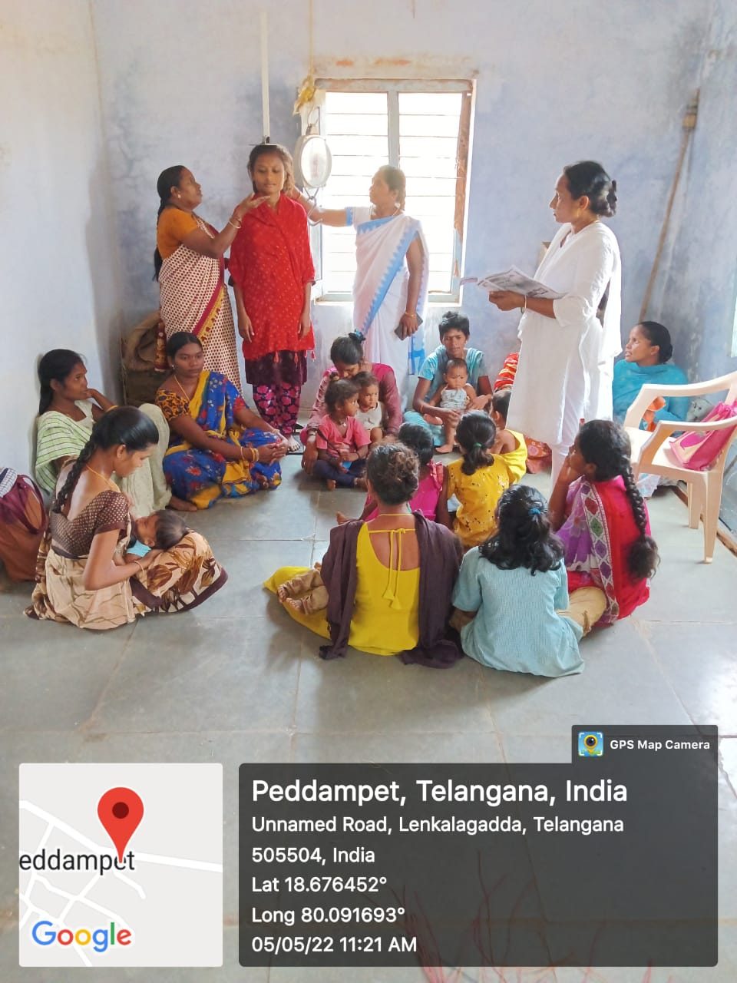
VHND & VHSNC
_{M Venkatamma DPHNO}
_{Sri M Komuraiah Dy DM&HO}

Slide 23
VHND & VHSNC Activities for the month of July 2022
Sl.No | Name of the PHC | No of ASHAs | No. of Subcenters | No. of Anganwadi Centers | No.of VHNDs Planned | No. of VHNDs Conducted | No. of VHNDs Balance | Topics
1 | PHC Ambatpally | 29 | 9 | 72 | 72 | 72 | 0 | 1.Maternal Health
2 | PHC Azamnagar | 14 | 4 | 30 | 30 | 30 | 0 | 2.Child Immunization
3 | PHC Bupalpally | 68 | 8 | 72 | 72 | 72 | 0 | 3.Nutrition
4 | PHC Chelpur | 23 | 5 | 32 | 32 | 32 | 0 | 4.Family Planning
5 | PHC Ghanpur | 17 | 5 | 23 | 23 | 23 | 0 | 5.RTI/STI
6 | PHC Kataram | 38 | 9 | 52 | 52 | 52 | 0 | 6.Communicable diseases
7 | PHC Mahamutharam | 25 | 9 | 71 | 71 | 71 | 0 | 7.Non Communicable diseases
8 | PHC Mogullapally | 42 | 9 | 67 | 67 | 67 | 0 | 8.Gender Ratio/SEX Ratio
9 | PHC Regonda | 71 | 12 | 83 | 83 | 83 | 0 | 9.Health Promotions
10 | PHC Thadicherla | 23 | 8 | 42 | 42 | 42 | 0 | 10.Sanitation
11 | PHC Velishala | 33 | 6 | 48 | 48 | 48 | 0 | 11.SSFP,SAM&MAM
12 | PHC Vodithala | 35 | 6 | 52 | 52 | 52 | 0 | 12.ANC Birth Plan
 | TOTAL | 418 | 90 | 644 | 644 | 644 | 0 | 13.Immunazation

Slide 24
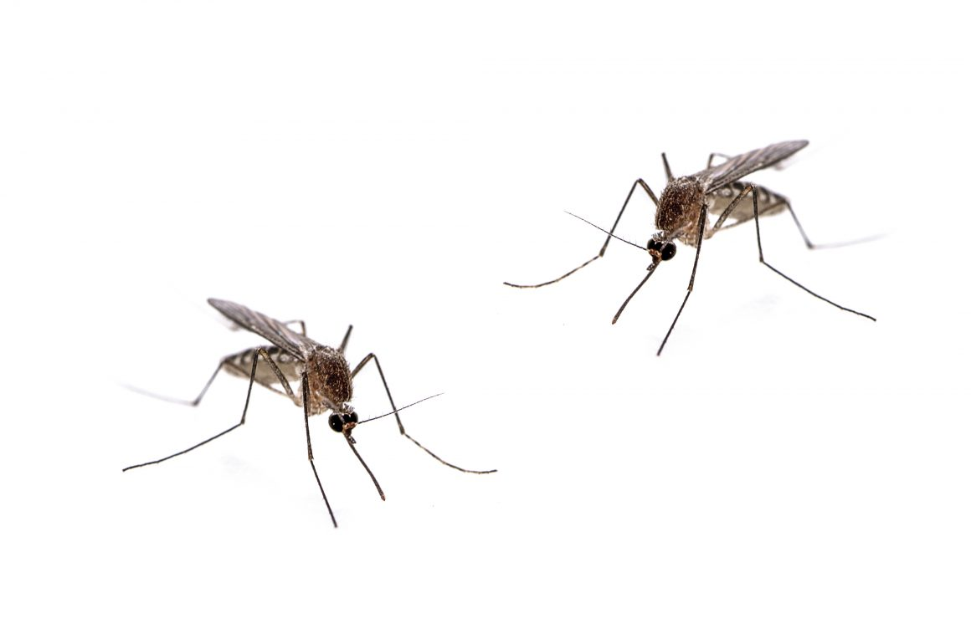
NVBDCP
Programme Officer Dr V Umadevi _{MBBS}

Slide 25
NVBDCP for the month of July 2022:
S.No | PHC Name | No of Sub Centers | No of Sub Centers Identified | No of High Risk Villages | Jul-22 |  |  |  |  |  |  |  | Jan 22 up to July 2022
 |  |  |  |  | No of RDT Test Done | No of BS Collection Done | No of Positives Cases in |  |  |  |  |  | No of RDT Test Done | No of BS Collection Done | No of Positives Cases in
 |  |  |  |  |  |  | Malaria |  |  | Dengue | Chikungunya | No of Filaria Cases |  |  | Malaria |  |  | Dengue | Chikungunya | No of Filaria Cases
 |  |  |  |  |  |  | PV | PF | Total |  |  |  |  |  | PV | PF | Total
1 | Ambatipally(24*7 PHC) | 5 | 3 | 15 | 165 | 489 | 0 | 0 | 0 | 0 | 0 | 0 | 760 | 2641 | 0 | 1 | 1 | 1 | 0 | 4
2 | Azamnagar(24*7 PHC) | 4 | 1 | 3 | 209 | 274 | 0 | 1 | 1 | 0 | 0 | 0 | 1197 | 1320 | 0 | 1 | 1 | 0 | 0 | 3
3 | Bhupalpally(UPHC) | 8 | 0 | 0 | 322 | 742 | 0 | 3 | 3 | 0 | 0 | 0 | 1533 | 3675 | 0 | 3 | 3 | 0 | 0 | 58
4 | Chelpur(24*7 PHC) | 5 | 0 | 0 | 185 | 287 | 0 | 0 | 0 | 0 | 0 | 0 | 849 | 1816 | 1 | 0 | 1 | 0 | 0 | 17
5 | Ghanpur (Mulug)(24*7 PHC) | 5 | 0 | 0 | 180 | 246 | 0 | 0 | 0 | 0 | 0 | 0 | 874 | 1216 | 0 | 0 | 0 | 1 | 0 | 10
6 | Kaleswaram(PHC) | 4 | 0 | 0 | 0 | 0 | 0 | 0 | 0 | 0 | 0 | 0 | 0 | 0 | 0 | 0 | 0 | 0 | 0 | 0
7 | Kataram(24*7 PHC) | 9 | 0 | 0 | 444 | 404 | 0 | 1 | 1 | 0 | 0 | 0 | 3850 | 1758 | 1 | 1 | 2 | 0 | 0 | 6
8 | Maha Muthram(24*7 PHC) | 9 | 0 | 0 | 73 | 313 | 0 | 2 | 2 | 1 | 0 | 0 | 418 | 1699 | 0 | 3 | 3 | 3 | 0 | 10
9 | Mogullapally(PHC) | 9 | 0 | 0 | 166 | 431 | 1 | 0 | 1 | 0 | 0 | 0 | 651 | 2425 | 1 | 0 | 1 | 0 | 0 | 83
10 | Regonda(24*7 PHC) | 12 | 0 | 0 | 418 | 840 | 0 | 1 | 1 | 0 | 0 | 0 | 1741 | 4225 | 0 | 1 | 1 | 0 | 0 | 43
11 | Thadicharla(PHC) | 8 | 0 | 0 | 171 | 361 | 0 | 0 | 0 | 0 | 0 | 0 | 786 | 2212 | 0 | 0 | 0 | 0 | 0 | 22
12 | Velishala(24*7 PHC) | 6 | 0 | 0 | 303 | 326 | 0 | 0 | 0 | 0 | 0 | 0 | 1618 | 1884 | 0 | 0 | 0 | 0 | 0 | 34
13 | Vodithala(PHC) | 6 | 0 | 0 | 176 | 374 | 0 | 2 | 2 | 0 | 0 | 0 | 1369 | 2252 | 0 | 2 | 2 | 1 | 0 | 100
 | Total | 90 | 4 | 18 | 2812 | 5087 | 1 | 10 | 11 | 1 | 0 | 0 | 15646 | 27150 | 3 | 12 | 15 | 6 | 0 | 390

Slide 26
NVBDCP REPORT
S. No | Particulars | Jul-22 |  | Jan 22 to Jul 22
 |  | District Report | Tribal Area | District Report | Tribal Area
1 | Fever Cases Recorded | 5087 | 274 | 27150 | 801
2 | No of RDT Conducted | 2812 | 209 | 15646 | 1197
3 | Positives | 11 | 1 | 15 | 1
4 | No of BS Slides Taken | 5087 | 274 | 27150 | 1420
 | Active | 3802 | 172 | 19840 | 699
 | Passive | 1285 | 102 | 7343 | 721
 | M & C | 283 | 51 | 410 | 0
5 | No of PV Positives (RDT+Slides) | 1 | 0 | 3 | 0
6 | No of PF Positives (RDT+Slides) | 10 | 1 | 12 | 1
7 | Total Malaria Cases | 11 | 0 | 15 | 1
8 | Positive cases Age Group (0-4 years) | 0 | 0 | 0 | 0
 | Male | 0 | 0 | 0 | 0
 | Female | 0 | 0 | 0 | 0
9 | Positive cases Age Group (5-15 years) | 6 | 1 | 6 | 0
 | Male | 1 | 1 | 1 | 0
 | Female | 5 | 0 | 5 | 0
10 | Positive cases Age Group (15 years above) | 5 | 0 | 9 | 0
 | Male | 3 | 0 | 4 | 0
 | Female | 2 | 0 | 5 | 0
11 | No of Dengue Cases | 1 | 0 | 6 | 0
12 | No of Chikungunya Cases | 0 | 0 | 0 | 0
13 | No of SC Population Effected | 536 | 22 | 2361 | 22
14 | No of ST Population Effected | 589 | 165 | 3356 | 165
15 | No of Pregnant Women Effected | 0 | 0 | 0 | 0
16 | Positive Cases treated with Act | 0 | 0 | 0 | 0
17 | No of Malaria cases referred | 0 | 0 | 0 | 0
18 | No of Deaths Reported | 0 | 0 | 0 | 0
19 | Friday Dryday Activities | 276 | 12 | 517 | 84

Slide 27
Medical Camp Report in July 2022:
S.NO | PHC NAME | TOTAL POPULATION | TOTAL HOUSES | NO OF MEDICAL CAMPS PLANNED | MEDICAL CAMPS CONDUCTED | BALANCE CAMPS | NO OF OPD | NO OF BS COLLECTION | NO OF RDT TESTED | NO OF POSSITIVES | NO OF SOURCES IDENTIFIED | NO OF SOURCES REDUCTION
1 | AMBATPALLY | 19003 | 5832 | 17 | 26 | -9 | 2501 | 102 | 102 | 0 | 123 | 123
2 | AZAMNAGAR | 13635 | 3563 | 22 | 16 | 6 | 1065 | 41 | 41 | 0 | 186 | 186
3 | BHUPALPALLY | 75289 | 17053 | 17 | 15 | 2 | 1771 | 43 | 43 | 0 | 214 | 214
4 | CHELPUR | 25530 | 6337 | 17 | 21 | -4 | 1465 | 51 | 51 | 0 | 129 | 129
5 | GHANPUR | 16986 | 3963 | 13 | 10 | 3 | 854 | 42 | 42 | 0 | 228 | 228
6 | KALESHWARAM | 22743 | 6079 | 17 | 12 | 5 | 1205 | 51 | 51 | 0 | 102 | 102
7 | KATARAM | 39230 | 9418 | 13 | 28 | -15 | 1458 | 66 | 66 | 0 | 235 | 235
8 | MAHAMUTHARAM | 28876 | 7451 | 13 | 13 | 0 | 1623 | 48 | 48 | 0 | 248 | 248
9 | MOGULLAPALLY | 40985 | 9877 | 16 | 15 | 1 | 1215 | 54 | 54 | 0 | 268 | 268
10 | REGONDA | 60925 | 15667 | 17 | 22 | -5 | 2325 | 108 | 108 | 0 | 277 | 277
11 | THADICHERLA | 29120 | 8338 | 16 | 14 | 2 | 799 | 45 | 45 | 0 | 104 | 104
12 | VELISHALA | 30872 | 8517 | 17 | 13 | 4 | 1019 | 44 | 44 | 0 | 191 | 191
13 | VODITHALA | 34630 | 11036 | 13 | 20 | -7 | 1065 | 52 | 52 | 0 | 264 | 264
TOTAL |  | 437824 | 113131 | 208 | 225 | -17 | 18365 | 747 | 747 | 0 | 2569 | 2569

Slide 28

NLEP
Programme Officer Dr V Umadevi _{MBBS}

Slide 29
Facility Wise on Hand Cases and P.R. in NATIONAL LEPROSY ERADICATION PROGRAMME up to the month of July, 2022
Sl. No. | Name of the Institute | Cases at he End of Previous Month |  |  | A New Cases Detected |  |  | B Cases Discharged |  |  | C Cases Treated |  |  | D On Hand Cases |  |  | P.R.
 |  | MB | PB | Total | MB | PB | Total | MB | PB | Total | MB | PB | Total | M.B | PB | Total
1 | Ambatipally | 1 | 1 | 2 | 0 | 0 | 0 | 0 | 0 | 0 | 1 | 1 | 2 | 1 | 1 | 2 | 0.46
2 | Azamnagar | 1 | 0 | 1 | 0 | 0 | 0 | 1 | 0 | 1 | 1 | 0 | 1 | 0 | 0 | 0 | 0
3 | Bhupalpally | 10 | 0 | 10 | 0 | 1 | 1 | 2 | 0 | 2 | 10 | 1 | 11 | 8 | 1 | 9 | 1.01
4 | Chelpur | 3 | 0 | 3 | 0 | 0 | 0 | 0 | 0 | 0 | 3 | 0 | 3 | 3 | 0 | 3 | 1.33
5 | Ghanpur | 0 | 1 | 1 | 0 | 0 | 0 | 0 | 0 | 0 | 0 | 1 | 1 | 0 | 1 | 1 | 0.55
6 | Kaleshwaram | 0 | 0 | 0 | 0 | 0 | 0 | 0 | 0 | 0 | 0 | 0 | 0 | 0 | 0 | 0 | 0
7 | Kataram | 1 | 1 | 2 | 1 | 6 | 7 | 0 | 0 | 0 | 2 | 7 | 9 | 2 | 7 | 9 | 2.14
8 | Mahamutharam | 0 | 0 | 0 | 0 | 0 | 0 | 0 | 0 | 0 | 0 | 0 | 0 | 0 | 0 | 0 | 0
9 | Mogullapally | 2 | 0 | 2 | 0 | 0 | 0 | 0 | 0 | 0 | 2 | 0 | 2 | 2 | 0 | 2 | 0.45
10 | Odithala | 0 | 1 | 1 | 0 | 0 | 0 | 0 | 0 | 0 | 0 | 1 | 1 | 0 | 1 | 1 | 0.28
11 | Regonda | 2 | 0 | 2 | 0 | 0 | 0 | 0 | 0 | 0 | 2 | 0 | 2 | 2 | 0 | 2 | 0.29
12 | Thaticharla | 1 | 1 | 2 | 0 | 0 | 0 | 0 | 0 | 0 | 1 | 1 | 2 | 1 | 1 | 2 | 0.7
13 | Velishala | 0 | 0 | 0 | 0 | 0 | 0 | 0 | 0 | 0 | 0 | 0 | 0 | 0 | 0 | 0 | 0
 | TOTAL | 21 | 5 | 26 | 1 | 7 | 8 | 3 | 0 | 3 | 22 | 12 | 34 | 19 | 12 | 31 | 0.73

Slide 30

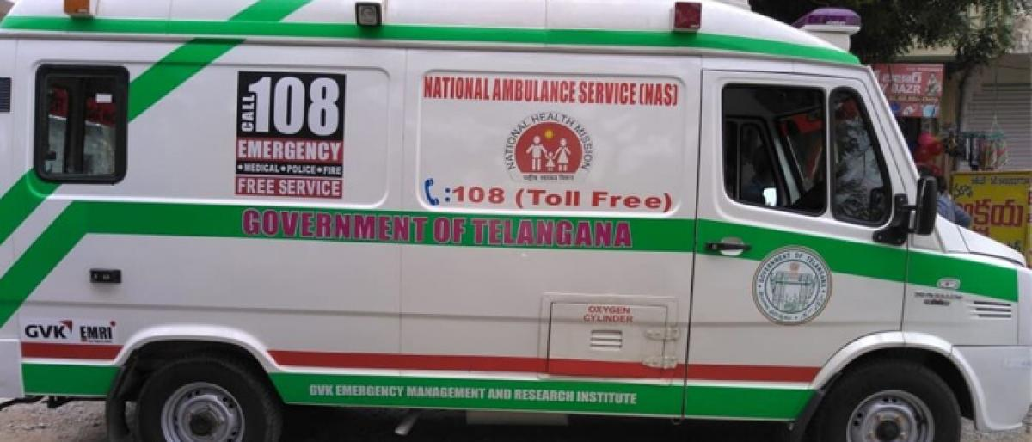
Aarogyasri, 108 and 102
Coordinators

Slide 31
Aarogyasri:
PHC Wise Preauths- upto July-2022
S. No | HOSP_NAME | Total
1 | Phc-Thadicharla | 7
2 | PHC-Ghanpur | 5
3 | PHC-Kataram | 4
4 | PHC-Mahamutharam | 4
5 | PHC-REGONDA | 4
6 | PHC-Mogullapally | 3
7 | PHC-CHELPUR | 2
8 | PHC-AZAMNAGAR | 2
9 | PHC-Bhupalapally | 2
10 | PHC-Velishala | 1
11 | PHC-Voditha | 1
12 | PHC-Ambatpally | 0
 | Total | 35
S. No | Month | Hospital Name | No of Patients | Therapies Raised | Threpies Raised Amount
1 | July-22 | CHC - Mahadevpur | 38 | 38 | 601600
2 | July-22 | CHC Chityala | 17 | 17 | 71400
3 | July-22 | Area Hospital Bhupalapally | Newly empaneled under Aarogyasri on 30-07-2022

Slide 32
108 Services:
SEGMENT | VEHICLE NUMBER | MEDICAL | Trips | UAD | UAD% | CC <30MIN | CC% | RCALL | PREG cases
GHANPUR | AP15TB7437 | 89 | 2.87 | 0 | 0.00% | 62 | 69.7% | 94.4% | 21
REGONDA | TS09UA6566 | 102 | 3.29 | 0 | 0.00% | 95 | 93.1% | 96.1% | 15
KATARAM | TS09UB9192 | 73 | 2.35 | 0 | 0.00% | 54 | 74.0% | 93.2% | 17
CHITYAL | TS09UB9193 | 104 | 3.35 | 0 | 0.00% | 96 | 92.3% | 89.4% | 15
MAHADEVPUR | TS09UB9200 | 78 | 2.52 | 0 | 0.00% | 67 | 85.9% | 91.0% | 22
MAHAMUTHARAM | TS09UC0485 | 76 | 2.45 | 0 | 0.00% | 46 | 60.5% | 93.4% | 26
BHUPALPALLY | TS09UD0408 | 89 | 2.87 | 0 | 0.00% | 77 | 86.5% | 86.5% | 33
TEKUMATLA | TS09UA6068 | 89 | 2.87 | 0 | 0.00% | 82 | 92.1% | 85.4% | 6

Slide 33
102 Services:
NAME OF THE HOSPITAL | NO OF VEHICLES | NO.OF PHC/CHC MAPPED UNDER SEGMENTS | IP COUNT / NO OF DELIVERIES CONDUCTED | NO OF BENEFIARIES SHIFTED BY 102 | OTHER HOSPITAL | % | TOTAL ANC / OP COUNT | NO.OF BENIFIARIES SHIFTED BY 102 | OTHER HOSPITAL | %
MAHAMUTHARAM | 1 | 2 | 110 | 20 | 0 | 18 | 888 | 461 | 0 | 52
MAHADEVPUR | 1 | 2 | 5 | 5 | 34 | 100 | 161 | 149 | 235 | 93
CHITYALA | 1 | 1 | 22 | 19 | 0 | 86 | 349 | 334 | 54 | 96
TOTAL | 3 | 5 | 137 | 44 | 34 | 32 | 1398 | 944 | 289 | 68
SEGNENT NAME | REGD NUMBER | TOTAL TRIPS | Total Beneficiaries | REVERSE TRANSPO CASES | ANC PICKUP | ANC DROP BACK CASES | PNC & VACCINATION | TOTAL CASES
MAHADEVAPUR | TS08UD7515 | 151 | 423 | 39 | 183 | 201 | 0 | 423
CHITYAL | TS08UD4654 | 153 | 485 | 19 | 213 | 253 | 0 | 485
MAHAMUTHARAM | TS08UD4642 | 144 | 481 | 20 | 220 | 241 | 0 | 481
TOTAL |  | 448 | 1389 | 78 | 616 | 695 | 0 | 1389
AVERAGE |  | 5 | 15 | 1 | 7 | 7 | 0 | 15

Slide 34


Renovations at Facilities
TSMSIDC, Engineers

Slide 35
PHC Renovations Taken up by TSMSIDC:
S. No | Facility Name | Status
1 | Kataram PHC
2 | Mogullapalle PHC
3 | Mutharam (Mahadevpur) PHC
PHC Additional Works Taken up by Tribal Welfare ITDA:
S. No | Facility Name | Status
1 | Regonda PHC
2 | Ghanpur PHC

Slide 36
Sl No | PHC | Name of the Medical Officer | ANM Name & Phone No | Sub Centre | Estimate Cost | T.A. Name with Phone No | Name of the Contractor | Stage of Work | ECV Amount
1 | Ambatipally | dr k pramod kumar 9951231887 | Hemalatha, 9441617352 | Brahmanpally | 4.90 | T.Ravikiran, 9177024775 | in tender process | - | 315797
2 | Ambatipally |  | BENLE, 9989072181 | Pankena | 5.10 | T.Ravikiran, 9177024775 | in tender process | - | 337321
3 | Ambatipally |  | kankadurga, 6304310639 | Suraram | 5.20 | T.Ravikiran, 9177024775 | in tender process | - | 340237
4 | PHC Kataram | dr ramarao 9573573046 | Sarojene, 9398401013 | Dhanwada | 4.20 | T.Ravikiran, 9177024775 | in tender process | - | 259802
5 | PHC Kataram |  | manorama, 9948034803 | Gangaram | 4.80 | T.Ravikiran, 9177024775 | in tender process | - | 310222
6 | PHC Mahamutharam | dr s gopinath 9652550306 | Muthkka,6300341383 | Borlagudem | 6.95 | M.Nithin, 7989859484 | G. Devender Reddy & Co. | work not started LOA SENT | 483107
7 | PHC Mahamutharam |  | Suryakala, 9912676632 | Kanukunoor | 6.10 | M.Nithin, 7989859484 | G. Devender Reddy & Co. | work not started LOA SENT | 412719
8 | PHC Mahamutharam |  | A.Rajitha, 9948455425 | Korlakunta | 6.55 | M.Nithin, 7989859484 | G. Devender Reddy & Co. | work not started LOA SENT | 450332
9 | PHC Mahamutharam |  | Komala, 9010044849 | Meenajipet | 5.75 | M.Nithin, 7989859484 | G. Devender Reddy & Co. | work not started LOA SENT | 380394
10 | PHC Mahamutharam |  | Sharada, 9618320762 | Mulugupally | 6.15 | M.Nithin, 7989859484 | G. Devender Reddy & Co. | work not started LOA SENT | 416463
11 | PHC Mahamutharam |  | Sulochana, 8106512912 | Pegadapally | 6.55 | M.Nithin, 7989859484 | G. Devender Reddy & Co. | work not started LOA SENT | 450500
12 | Thadicherla | dr s gopinath 9652550306 | Bhagyalaxmi, 9866894123 | Ansanpally | 4.30 | T.Ravikiran, 9177024775 | Kakatiya Constructions | work not started LOA SENT | 265942
13 | Thadicherla |  | laxmi, 9848766034 | Peddathundla | 5.20 | T.Ravikiran, 9177024775 | in tender process | - | 343801
14 | Velishala | dr raju 9347831688 | Rajeshwari, 8790682252 | Giddamutharam | 4.40 | T.Ravikiran, 9177024775 | M/s. Kamala Constructions | work started | 275491
15 | Velishala |  | Bhagya laxmi, 9177930836 | Tekumatla | 4.80 | T.Ravikiran, 9177024775 | M/s. Kamala Constructions | work not started LOA SENT | 309632
16 | Vodithala |  | Radha, 8897150432 | Doothpalli | 5.40 | T.Ravikiran, 9177024775 | M/s. Kamala Constructions | work not started LOA SENT | 360084

Slide 37
Sub Centers Under Construction from various PR, TW agencies
S. No | Agency Name | Sub Center Name
1 | Rurban-(3) Sub centers | 1.Gorlaveedu
 |  | 2.Kompally
 |  | 3 Kamalapur
2 | DMFT- (6) Sub Centers | 1.Madathapally
 |  | 2.Gorukothapally
 |  | 3.Gorlaveedu
 |  | 4.Kodavatancha
 |  | 5.Jangedu
 |  | 6.Kasimpally
3 | NHM Tribal Welfare | 1. Azamnagar
Remarks: Gorlaveedu Sub center is constructed under DMFT and sanctioned again under Rurban.

Slide 38
Status of Ayush Dispensary Upgradation as HWC taken up by PR Dept:
S. No | Mandal Name | Village Name | Dispensary Name | Status
1 | Kataram | Damerakunta | Ayurvedic Dispensary
2 | Ghanpur M | Dharmaraopet | Ayurvedic Dispensary
3 | Regonda | Kodavatancha | Ayurvedic Dispensary
4 | Chityala | Challagarige | Homoeo Dispensary
5 | Mahamutharam | Mahamutharam | Homoeo Dispensary
6 | Mahadepvur | Kaleshwaram | Unani Dispensary
7 | Mogullapally | Mogullapally | Unani Dispensary
8 | Malharrao | Vallamkunta | Unani Dispensary

Slide 39

Ayush Dispensaries
District Nodal Person Dr Thanuja Rani

Slide 40
Ayush Department Dispensaries in District:
S. No | Mandal Name | Village Name | Dispensary Name | Doctor Name & Contact No | OPD in July 2022
1 | Kataram | Damerakunta | Ayurvedic Dispensary | Dr K Thanujarani 996601309 | 294
2 | Ghanpur M | Dharmaraopet | Ayurvedic Dispensary | Dr Madhumita 799701826 | 481
3 | Regonda | Kodavatancha | Ayurvedic Dispensary | Dr E Sunitha 9908431655 | Door Lock
4 | Chityala | Challagarige | Homoeo Dispensary | Dr E Sunitha 9908431655 | 613
5 | Mahamutharam | Mahamutharam | Homoeo Dispensary | Dr Aruna 9618991771 | 512
6 | Mahadepvur | Kaleshwaram | Unani Dispensary |  | Door Lock
7 | Mogullapally | Mogullapally | Unani Dispensary |  | Door Lock
8 | Malharrao | Vallamkunta | Unani Dispensary |  | Door Lock

Slide 41
NHM Ayush Dispensaries:
S. No | Mandal Name | PHC Name | Dispensary | Doctor Name & Contact No | OPD in July 2022
1 | Bhupalpally | PHC Azamnagar | NHM Ayush | Dr Sadanandham 9618598956 | 498
2 | Bhupalpally | PHC Bhupalpally | NHM Homeo | Dr Ajay 7989580507 | 542
3 | Ghanpur M | PHC Chelpur | NHM Ayush | Dr Geetha 9989529252 | 243
4 | Ghapur M | PHC Ghanpur M | NHM Homeo | Dr Narmada 9059426449 | 417
5 | Kataram | PHC Kataram | NHM Ayush | Dr Mahesh 8801348699 | Under Deputation
6 | Malharrao | PHC Thadicherla | NHM Ayush | Dr Raju | 407
7 | Mahadevpur | PHC Ambatpally | NHM Ayush | Dr Jagadish Khanna 9492648475 | Under Deputation

Slide 42


Quality Assurance
Management
_{Sri Chiranjeevi T DPO NHM}
_{Sri D Bhanu Kumar DQAM-NHM}

Slide 43
NQAS Certified Facilities in the year 2021-2022
Sl. No | Facility Name | Category
1 | PHC Regonda | Awarded with 92.7% in Mar 22
2 | PHC Ghanpur | Awarded with 93.5% in Apr 22
NQAS & LaQshya Proposed PHCs & HWCs for the year 2022-2023
Sl. No | Facility Name | Facility Type | Proposed for
1 | PHC Kataram | PHC | NQAS
2 | PHC Mogullapally | PHC | NQAS
3 | PHC Mahamutharam | PHC | NQAS
4 | HWC Dhanwada | HWC | NQAS
5 | HWC Gollabudharam | HWC | NQAS
6 | HWC Moranchapally | HWC | NQAS
7 | CHC Chityala | CHC | LaQshya
*National Quality Assurance Standards Certification
*Labour Room Quality Improvement Initiative

Slide 44
Biometric Attendance Status:
Sl. No. | Name of the Institute | Device Installation | Enrollment
1 | O/o DM&HO | Yes | Completed
2 | O/o Dy DM&HO | Yes | Partial
3 | CHC Chityala | Yes | Partial
4 | CHC Mahadevpur | Yes | Partial
5 | Ambatpally | Yes | Partial
6 | Azamnagar | Yes | Partial
7 | Bhupalpally | Yes | Partial
8 | Chelpur | Yes | Partial
9 | Ghanpur | Yes | Partial
10 | Kaleshwaram | Yes | Partial
11 | Kataram | Yes | Partial
12 | Mahamutharam | Yes | Partial
13 | Mogullapally | Yes | Partial
14 | Odithala | Yes | Partial
15 | Regonda | Yes | Completed
16 | Thaticharla | Yes | Partial
17 | Velishala | Yes | Partial

Slide 45
Thank you
District Medical & Health Officer
_{Jayashankar Bhupalpally}

